Slide 1
National Outreach Survey for Transportation (2021)
Awareness & Training Slide Decks
Presentation: Anti-Human Trafficking Strategies for Transportation Agencies
Content from the original presentation may have been removed, including but not limited to contact information and titles.
Delete this slide

Slide 2
This Slide Deck includes NOST data used in various presentations.
NOST Usage & Attribution Section
USAGE
Slides: The slide decks may be used in part or in whole when including NOST data in your marketing collateral, presentation, white papers, or journal articles
QR Codes: NOST QR codes can be used in documents or presentations to allow for quick access to the NOST report or individual chapters
UAS Logo: Usage of the United Against Slavery logo is limited to include on a slide with NOST data or for UAS contact information; permission to use the UAS logo cannot be included on a cover/title slide as a presenter for United Against Slavery unless otherwise agreed upon by UAS leadership
ATTRIBUTION
Please include proper attribution for NOST references:
Short Citation: National Outreach Survey for Transportation (2021)
Long Citation: Wigle, C., & Baglin, C. (Eds.). (2023). National Outreach Survey for Transportation: Combating Human Trafficking by Listening to Experiences, Challenges, and Recommendations of Frontline Workers and Those with Lived Experience (2021). United Against Slavery. [https://files.unitedagainstslavery.org/s/d/NOST-2021-Final-Report]
Contact Information:
United Against Slavery
(e) research@unitedagainstslavery.org
(w) www.unitedagainstslavery.org
* Delete this slide

Slide 3
National Outreach Survey
for Transportation (NOST)
Anti-Human Trafficking Strategies for Transportation Agencies

Slide 4
Human Trafficking
Human Trafficking under federal law:
(A) Sex trafficking in which a commercial sex act is induced by force, fraud, or coercion, or in which the person induced to perform such act has not attained 18 years of age; or
(B) The recruitment, harboring, transportation, provision, or obtaining of a person for labor or services, through the use of force, fraud, or coercion for the purpose of subjection to involuntary servitude, peonage, debt bondage, or slavery
>40 states have their own human trafficking laws

Slide 5
Common scenarios for Human Trafficking (HT)
Exotic Dancing (not involving sex acts)
Escort Services
Illicit Massage, Health and Beauty
Outdoor Solicitation
Bars, Strip Clubs, Cantinas
Remote Interactive Sex Acts
Personal Sexual Servitude
Pornography
Residential
Domestic Work
Traveling sales crews
Begging & Peddling
Agriculture & Animal Husbandry
Health & Beauty Services
Construction
Restaurants & Food Service
Hotels & Hospitality
Landscaping
Commercial cleaning services
Factories & Manufacturing
Carnivals
Forestry & Logging
Health Care
Recreational Facilities
Illicit activity (drug trafficking, etc.)
Child bride
Organ trafficking
Source:
Polaris, 2017

Slide 6
Systems to counter human trafficking (United States)
Who is investigated and prosecuted?
The Trafficker and accomplices
Who is sued in a civil case?
The Trafficker
Who takes a programmatic or strategic perspective?
Government, education & advocacy non-profits, professional associations, task forces, sectoral efforts
Who watches out for victims and survivors?
A knowing user of illegal services
User of minor sex
Enablers/Companies that knowingly benefit financially
Recruiters
Employers
Financial Institutions
Bars, clubs, truck stops, motels/hotels
Any company with human trafficking in its supply chain
The court, law enforcement, and the prosecutor (by statute)
Witness Protection Programs (as appropriate)
Crime Victim Advocates
Crime Victim Service Providers
Civil litigators
Professionals providing long-term care to Victims and Survivors

Slide 7
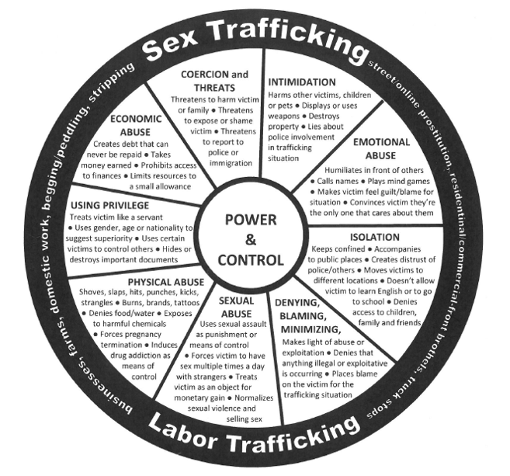
Source:
Polaris, 2010
Compare:
smuggling; legal sex-industry work;
exploitative labor practices

Slide 8
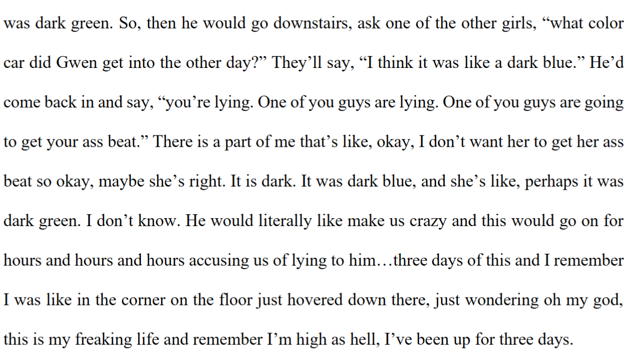
Excerpt of an interview from the following source: Michaelis, A., Lundstrom, M., Henderson, A. (2022, May) The Role of Addictive Substances in Different Types of Sex Trafficking. Urban Crime – An International Journal 3:1

Slide 9
Transportation sector’s role & drivers: select examples
>570 signers - including all 50 states - of USDOT’s Transportation Leaders Against Human Trafficking (TLAHT) pledge to
Raise awareness
Educate the workforce to recognize and report suspected signs
“The Ask”: Observe, Identify, & Report
Track and share key data points
Under P.L. 117-301 (December 2022)
USDOT to coordinate placing the national human trafficking hotline “in the restrooms of each…aircraft, airport, over-the-road bus, bus station, passenger train, and passenger railroad station”
DHS to cover ports of entry
Reporting, training, and other rules relating to commercial vehicle licenses
Training by education & advocacy non-profits (e.g., Truckers Against Trafficking, Busing on the Lookout, several others), agencies, task forces, etc.

Slide 10
NOST Study Summary
>120 collaborators
IRB approval of survey: May 2021
>600 questions
>150 job positions
50 organizations distributed the survey to staff / members
Open: July – November 2021
Respondents: 3,896
212 survivors among the 3,896
Highest participation from
Aviation (52%)
State DOT staff (20%)
Law Enforcement (9%)
Data Visualization Toolkit
400+ ready-to-use visuals
Report
20+ chapters
Contextualizing the NOST’s “data for social good”
Other resources
Dataset
Data Dictionary
Links to additional resources

Slide 11
NOST Report Chapters
Society
General Opinion
Private Sector
Modal Providers & State DOTs
Aviation
Roadway
Transit
Maritime (low data)
Rail
Pipelines (low data)
State DOTs
Law & Governance
State Laws
Criminal Justice
Governance (Internal)
Workforce Roles & Perspectives
Training
Reporting
Mental Health
People Disproportionately Affected by Human Trafficking
Survivors
Labor & Sex Trafficking
Special Populations
Forced Labor
Indigenous
The Vulnerable / Underserved
Victim/Survivor Service Providers
TIPS
Map chapters to relevant staff
Survivor chapter integrates themes
Relevant to all

Slide 12
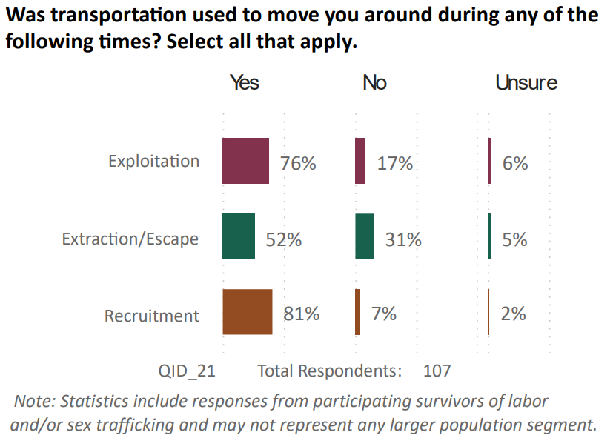
NOST data on the impact of transportation

Slide 13
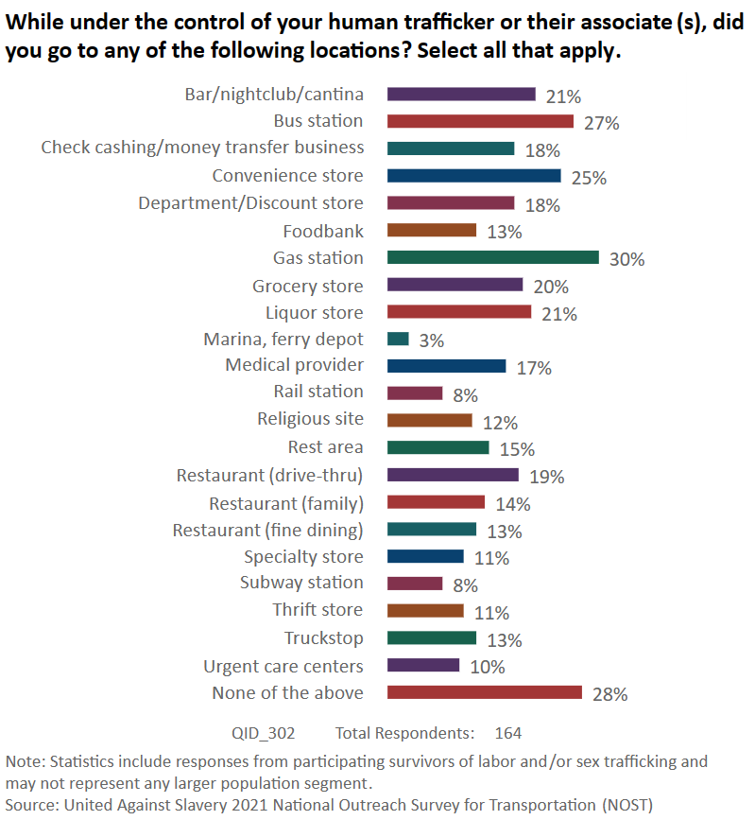
Places: What transport facilities were involved?

Slide 14
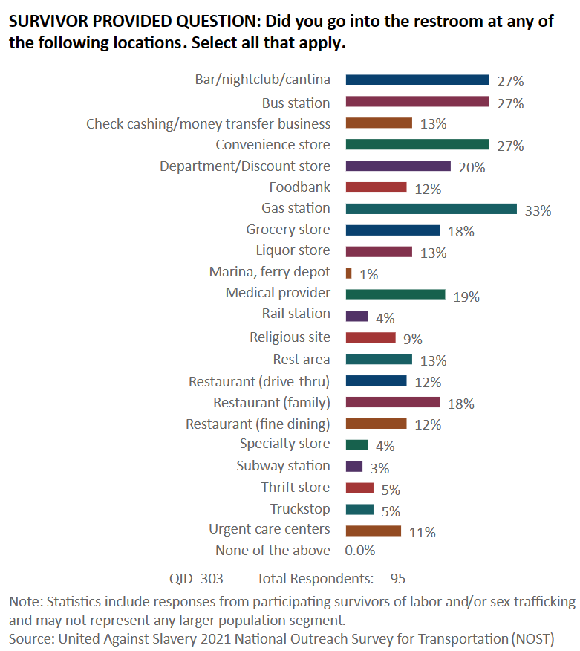
Chances: Were private spaces used at transport facilities?

Slide 15
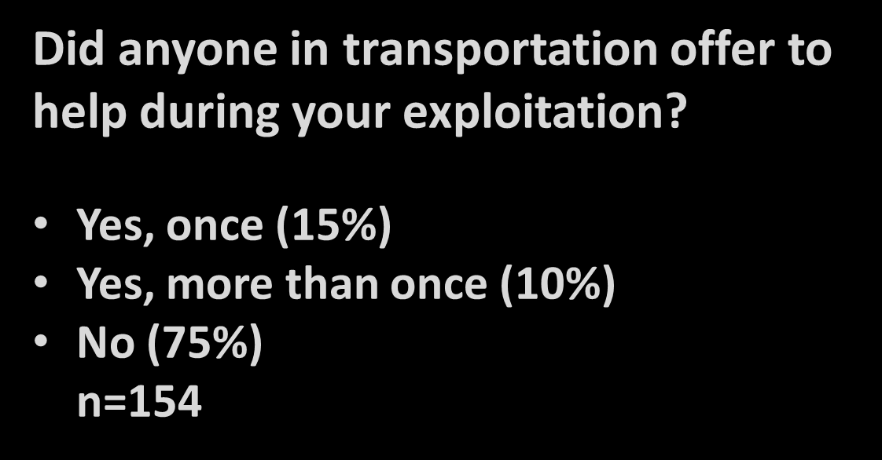
Interactions: Offering Assistance

Slide 16
Who offered help?
Survivor respondents (n=37) identified
Airline staff - Ticketing (16% - 6)
Airline staff - Gate attendant (14% - 5))
Airline staff - Luggage handler (11% - 4)
Airport staff (19% - 7)
Airport security checkpoint officer (e.g., TSA)
(3% - 1)
Border agent (16% - 6)
Convenience store personnel (16% - 6)
Driver - Bus (19% - 7)
Driver - Limousine (8% - 3)
Driver - Rideshare (5% - 2)
Driver - Shuttle (3% - 1)
Driver - Taxi (8% - 3)
Driver - Truck (11% - 4)
Flight attendant or pilot (5% - 2)
Gas station attendant (5% - 2)
Police (5% - 2)
Port worker (11% - 4)
Security guard (14% - 5)
Ship crew (5% - 2)
Rail platform personnel (e.g., transit, passenger rail) (8% - 3)
Truck stop personnel (14% - 5)
None of the above (14% - 5)
*These data represent a small sample of labor and sex trafficking survivors and may not reflect the experiences of all survivors.

Slide 17
Observing, identifying & reporting:
Transportation workforce concerns and hesitation

Slide 18
Addressing concerns and hesitation
Role of supervisors. 50% would discuss suspicions with their supervisor before deciding to report signs of HT.
Organizational Response. New or revised processes:
84% (N=923) say their organization is communicating HT efforts to partners, but only 26% say there is a designated point of contact
Half possessed or wanted a “resource card” with instructions for identifying and reporting HT
Q: Are protocols in place so employees know they are protected if they report and misidentify signs of HT?
A: Yes 31%; No 11%; Unsure 58% (n=504)

Slide 19
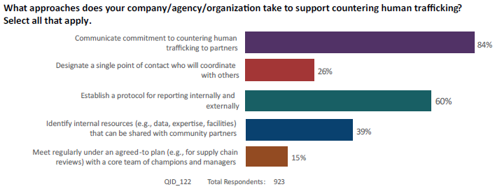
Engagement
Compliance
Comity
Championing/Committing
Organizational Responses
Convening
Commercial Sourcing
Commercial-like Services
Coordination with Partners
Collaboration with Partners
Core Mission Investments
Management

Slide 20
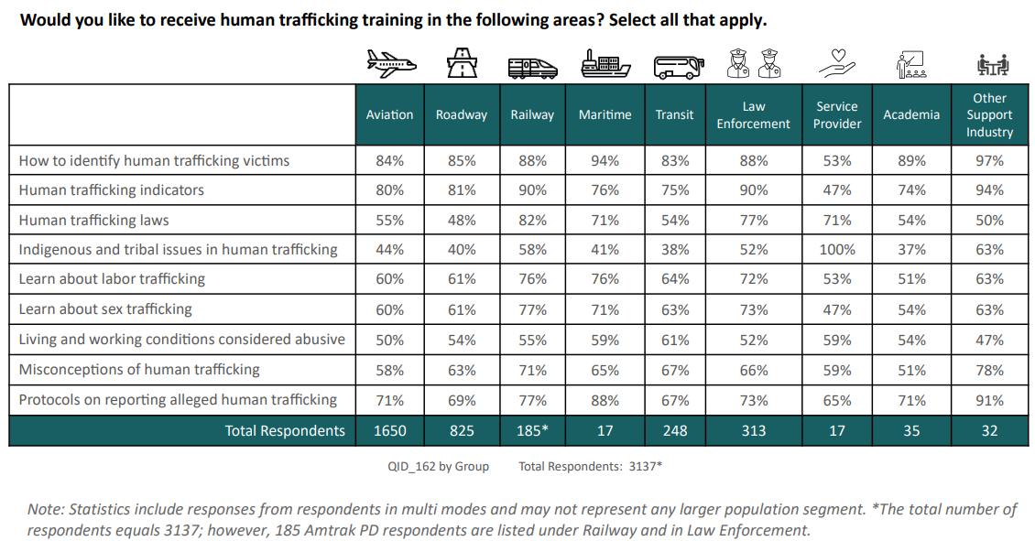
Addressing concerns and hesitation: Training types desired

